Slide 1

AudioWave: A Microservices-Based Audio Sharing Platform
Design and Implementation of a Full Microservices Architecture
By
Ward Zidani
Ahmad Bsese
Project Code: 24-1-D-44
Software Engineering Department
Braude - College of Engineering, Karmiel
Summer 2024

Slide 2
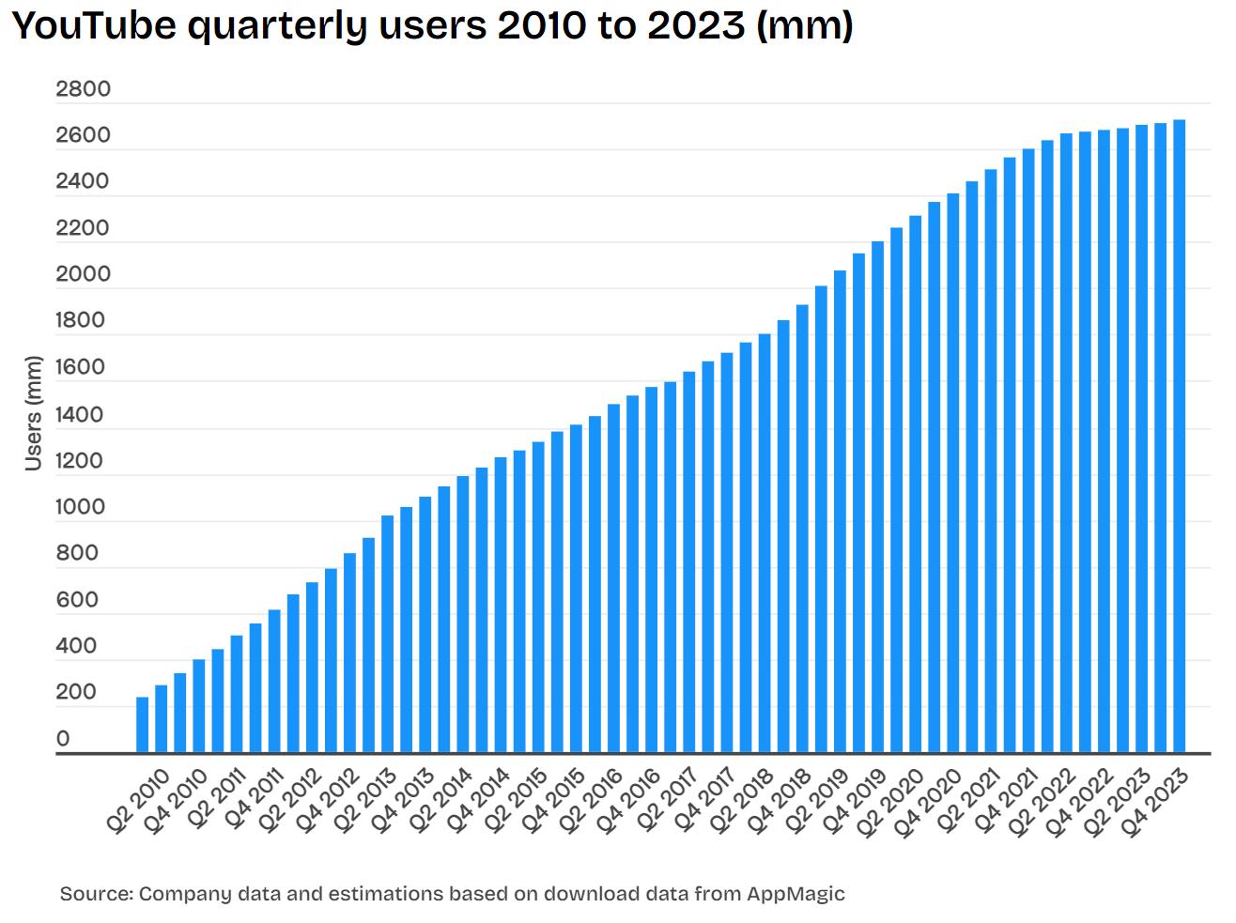
Introduction
The Expanding Role of the Web in Daily Life:-
Immense growth in web traffic with widespread internet access.
Importance of the web for various daily activities: Entertainment, education, finance, etc.

Slide 3

Challenges for Large Platforms
Millions of simultaneous visits strain platform resources.
Need for fast, responsive user experiences in competitive tech landscape.

Slide 4
Adapting Architecture for Traffic and Features
Continuous addition and evolution of features (e.g., user management).
Importance of architecture that supports scalability and feature integration without performance loss.

Slide 5

Introduction to Microservices
Microservices Architecture as a Solution
What is "Microservices"?

Slide 6

Project Scope and Objectives
What is AudioWave?
How does AudioWave operate?
How will AudioWave utilize microservices?

Slide 7
Software Meets Consumer Needs
The influx of internet users and the shift towards remote data access.
Emergence of platforms handling vast user traffic (e.g., Google, Facebook).
Importance of rapid data access and efficient resource management.

Slide 8
Transitioning to Microservices Architecture
Contrast with monolithic architecture.
Noteable Platforms

Slide 9
Relevance to Modern Platforms
Need for scalable, maintainable solutions in high-traffic platforms.
Microservices' role in facilitating quick response times and individual scalability.
Preview of case study: Building an audio sharing platform using microservices.

Slide 10
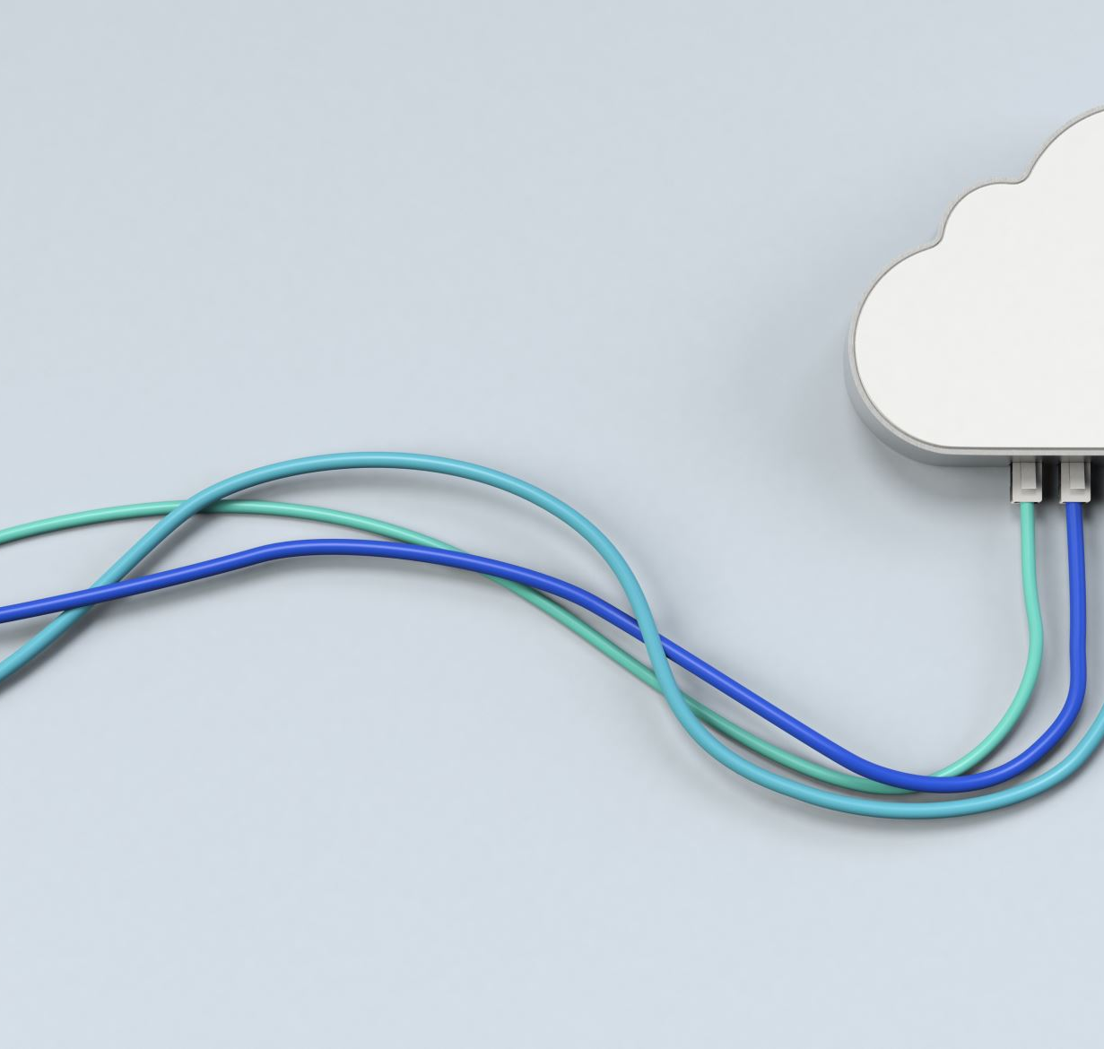
Microservices Architecture and System Components
Microservices Architecture: System divided into smaller, loosely coupled services with defined responsibilities.
API Gateway: Central entry point for platform client requests.
Virtual Private Cloud (VPC): Isolated, secure cloud within a public cloud.

Slide 11

Overview of Existing Audio Sharing Platforms
SoundCloud: Social, open UGC platform for sharing music.
Spotify: On-demand streaming of professionally produced music.

Slide 12
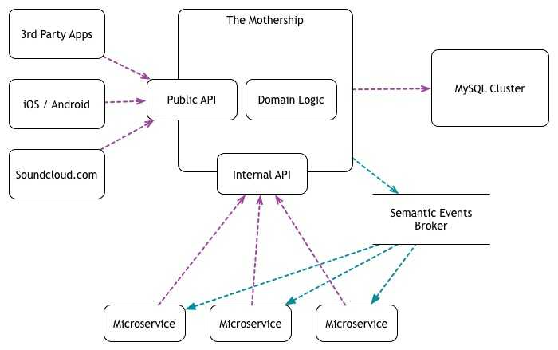
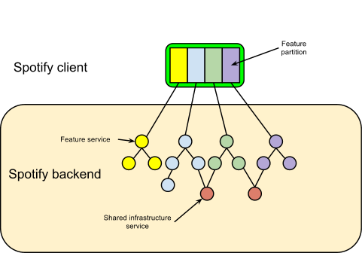
Backend Architectural Approaches
SoundCloud
Spotify

Slide 13
Distinguishing our Audio Sharing Platform
Open to all types of audio content, not just music.
No restrictions like pre-approved status or subscriptions for uploading content.
Aim to empower a broader spectrum of audio creators and consumers.

Slide 14

Advantages of Microservices for Our Platform
Scalability and flexibility in handling diverse and fluctuating traffic.
Ability to independently deploy and scale service components.

Slide 15

Frontend Evolution in Related Platforms
Spotify: From minimalistic to feature-rich, focusing on personalization and cross-platform compatibility.
SoundCloud: Enhancements for community engagement and creator empowerment.

Slide 16

Project Goals and Expected Outcomes
What are our main objectives?
How do we expect to benefit from implementing a non-monolithic architecture?

Slide 17
Key Technical Objectives
Dynamic Routing
Load Balancing
Security Measures

Slide 18
Scalability and Traffic Management
Importance of building a platform capable of handling high traffic volumes from the outset.
Anticipation of future growth and potential traffic peaks as a strategic advantage.

Slide 19

Product Vision and Market Impact
Niche focus on educational and relaxation audio content, addressing needs of multitasking individuals.
Market relevance in the context of rising living costs and the increasing pursuit of education and skill development.

Slide 20

Product Specifications and User Experience
Frontend Development: Details on the ReactTS web application and Flutter mobile application.
Backend Development: Microservices architecture, including API Gateway and VPC setup.
Unified API Usage: Both frontend applications to utilize the same data API endpoints for a coherent user experience.

Slide 21

Understanding the Product's Target Audience
The User: Broad audience, includes both content creators and consumers.
The Content Creator: Individuals like musicians, lecturers, bloggers.
The Content Consumer: Those seeking educational, entertainment, and informational content.

Slide 22
Project's Target Audience
Software Architect: Interested in effective, scalable software solutions.
DevOps Professional: Focused on automation, containerization, and system monitoring.
Developer Communities: Looking to learn and apply software architectural principles.

Slide 23
Functional Requirements of the Platform
User Account Management: Registration, login, and user profile management.
Search Functionality: Keyword, author, or subject-based search with user-friendly results.
Audio Player: Basic controls for playing, pausing, and skipping audio.
Content Management: Upload, manage, and privacy settings for audio content.
Content Streaming: Efficient loading and pre-loading of audio for seamless playback.

Slide 24
Non-Functional Requirements for System Performance
Scalability: Ability to handle load increases without performance loss.
Maintainability: Simplified updates and management through microservices.
Flexibility: Easy feature updates, additions, and removals.
Performance: Quick data processing to maintain user engagement.
Security and Reliability: Protect user data and ensure service reliability.

Slide 25
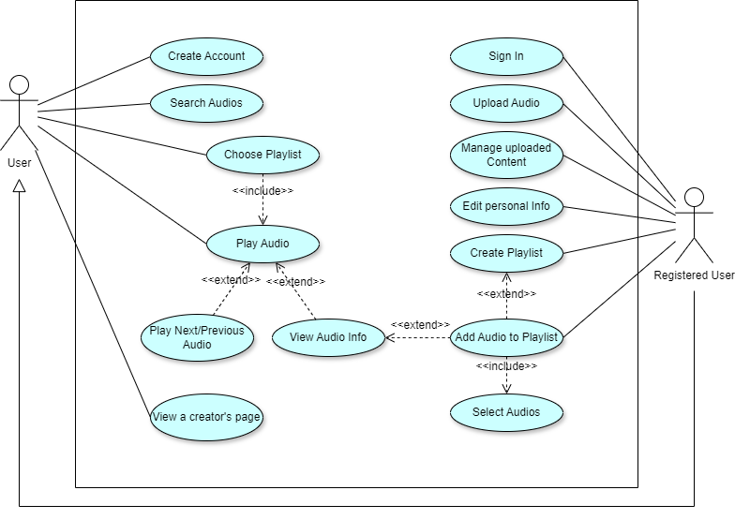
Diagrams and System Flows- use case

Slide 26
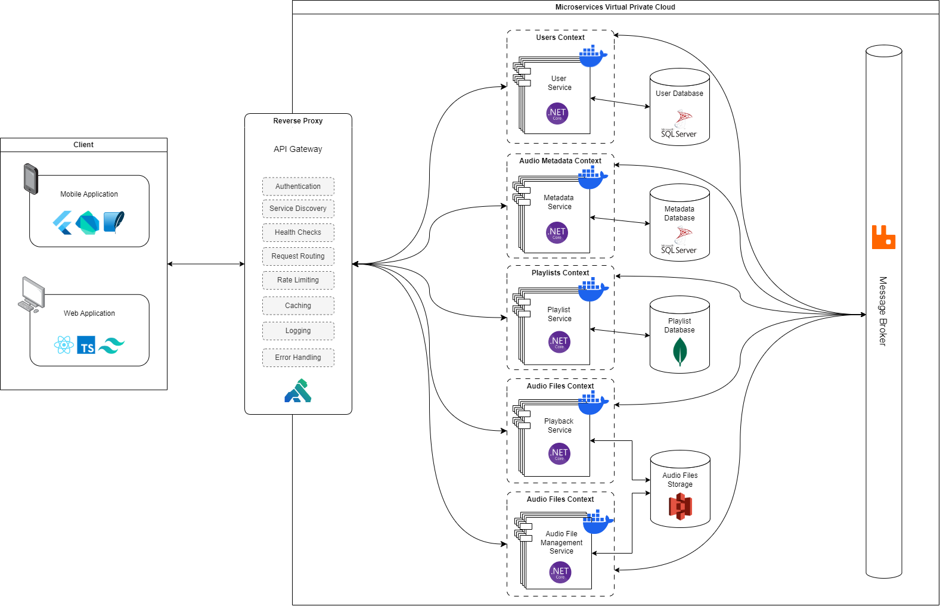
System Architecture

Slide 27
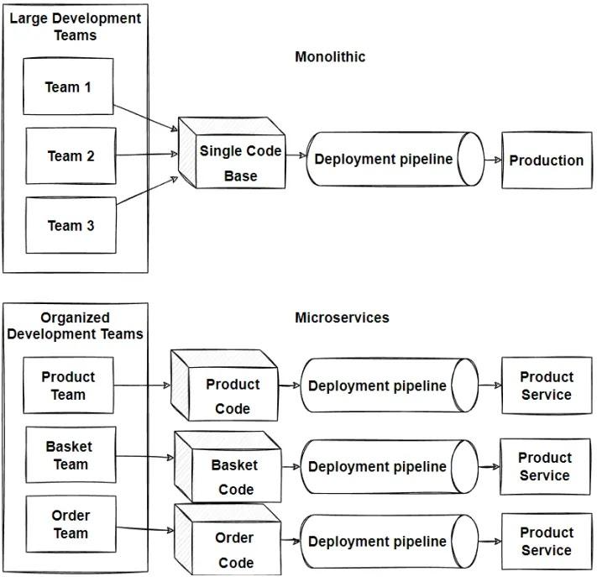
Backend Development: Microservices vs. Monolithic Architecture
Advantages of microservices: independent development, deployment, and scaling.

Slide 28
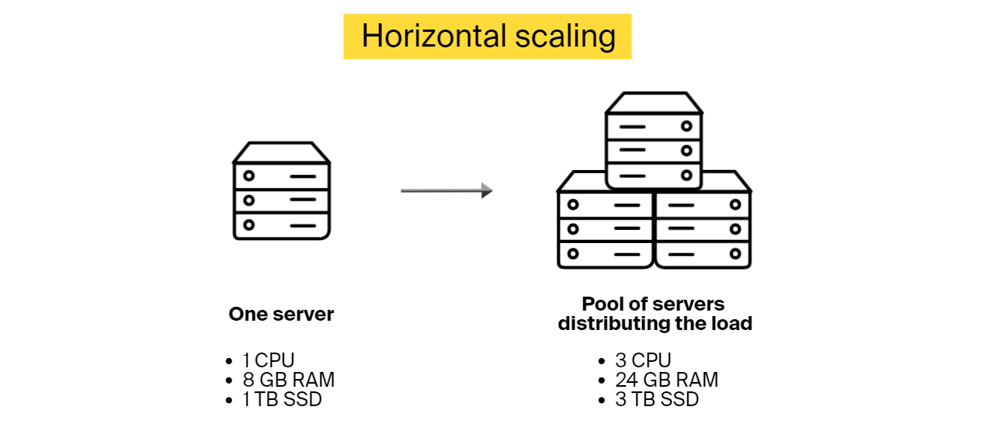
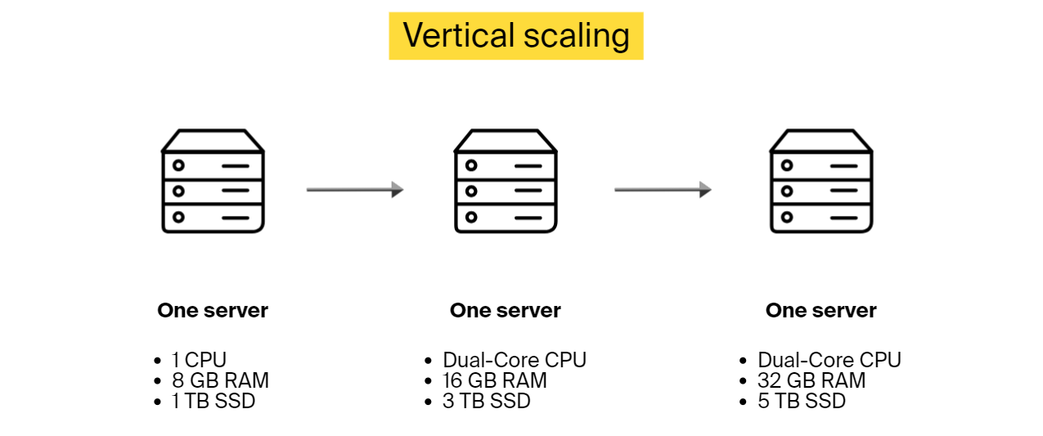
Scalability in Microservices
Vertical scaling
Horizontal scaling
Benefits of microservices in handling peak traffic efficiently.

Slide 29
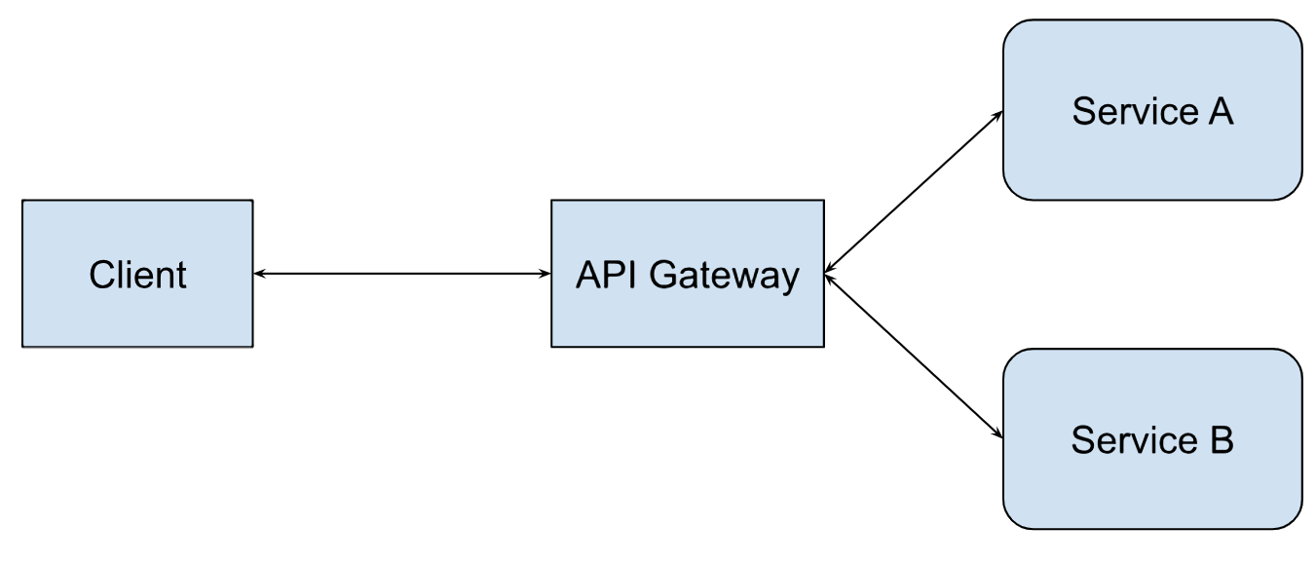
Role of the API Gateway
Functions of the API Gateway in routing requests.
Additional responsibilities: authentication, security, caching.

Slide 30

Freedom in Frameworks and Tools
Flexibility in choosing programming languages and databases.

Slide 31

Design: Crafting the Implementation Strategy
Importance of considering both Functional and Non-Functional requirements in design decisions
Highlighting the goal of designing a fast and performant platform, with features like background audio playback and offline listening
Decision to use Flutter for its speed, performance, and developer-friendly features

Slide 32
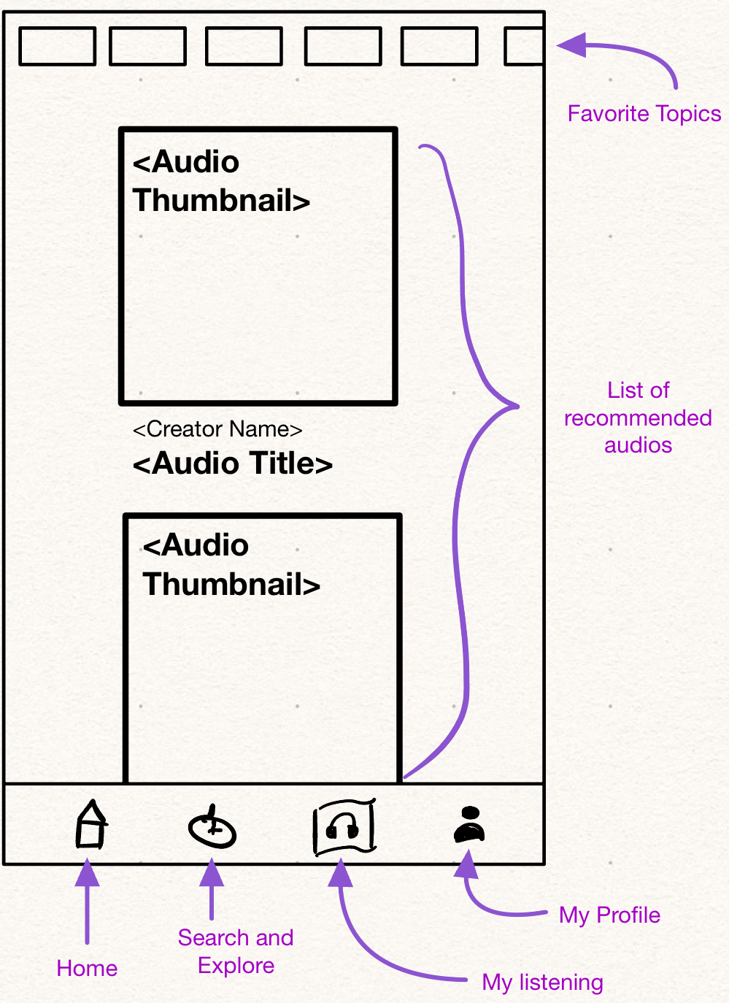
Main Pages Overview
Landing Page, of
Overview of the Search and Explore page, featuring trending audios, playlists, and topics
Description of the My Listening page, showcasing liked audios, history, and user-created playlists
Overview of the My Profile page, highlighting the user's creator page and profile options
Home page. Landing page of the app. Features personally suggested content.
Search and Explore page. Featuring trending audios, playlists, and topics
My Listening page. Features liked audios, history, and user-created playlists
My Profile page. Showcasing the user's creator page and profile options

Slide 33
Home Page
Most watched topics (tags)
Personally recommended audios

Slide 34
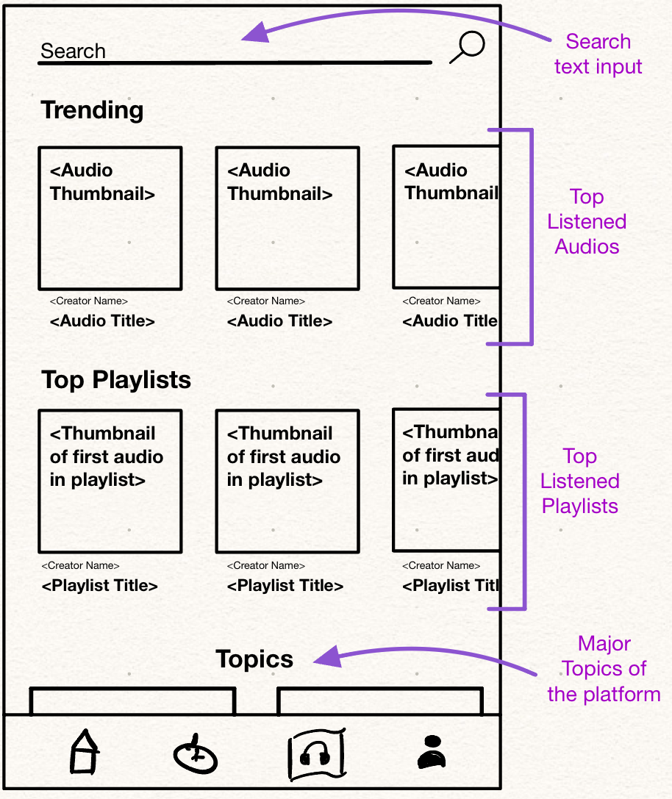
Search and Explore Page
Search Functionality
Trending Audios (horizontal)
Trending Playlists (horizontal)
Major Topics

Slide 35
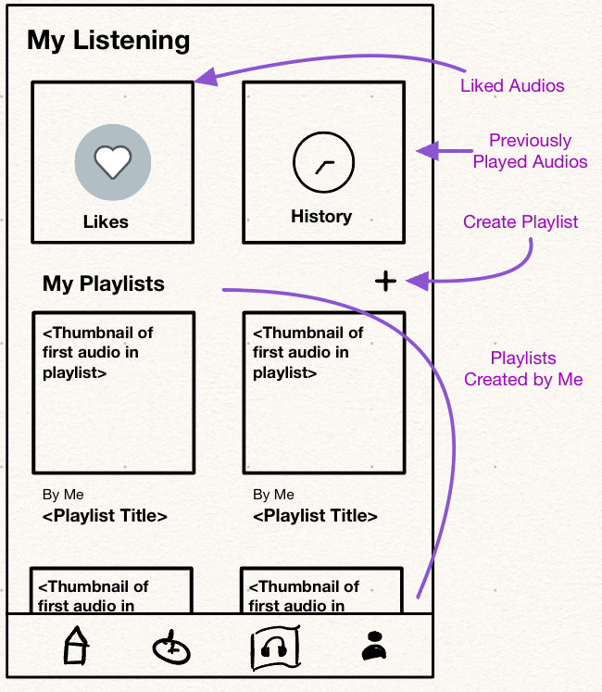
My Listening Page
Can view Likes & History
Personally created playlists
Button for creating a new playlist

Slide 36
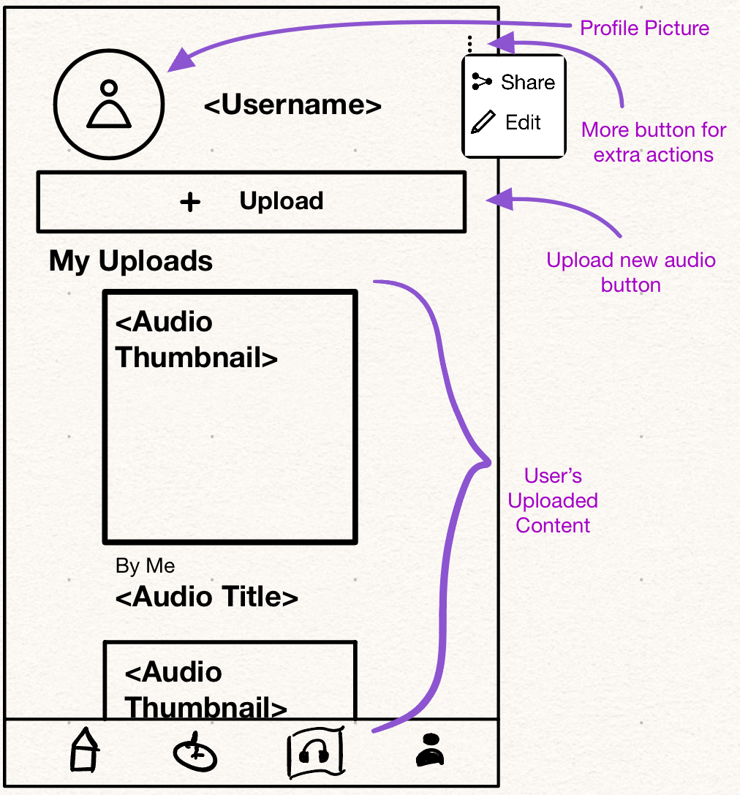
My Profile
Public personal profile page
Upload audio button
Scrollable card-view list of previous uploads
Options to share link for profile or edit the profile

Slide 37
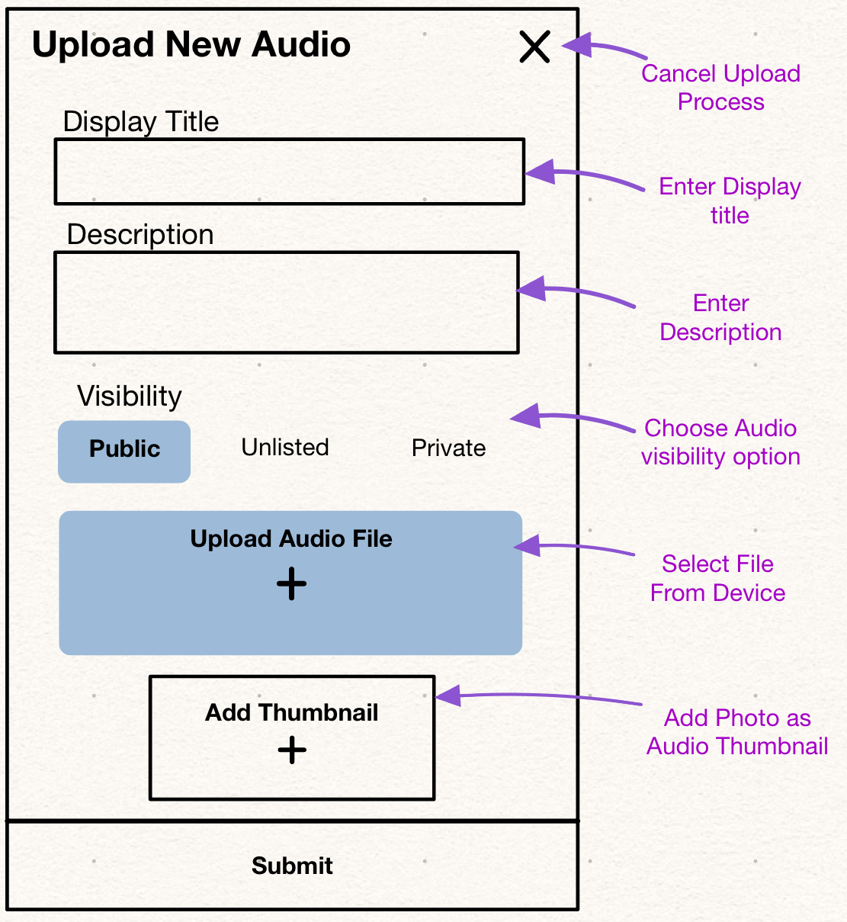
Upload New Audio Screen
Enter Audio info
Upload Audio
Upload Thumbnail

Slide 38
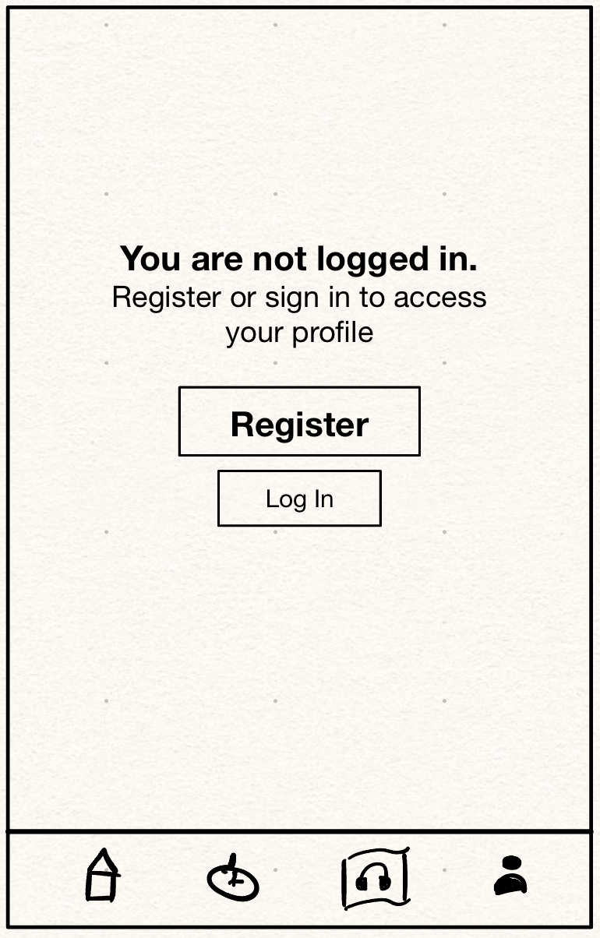
Login Screen
Prompted for certain pages

Slide 39
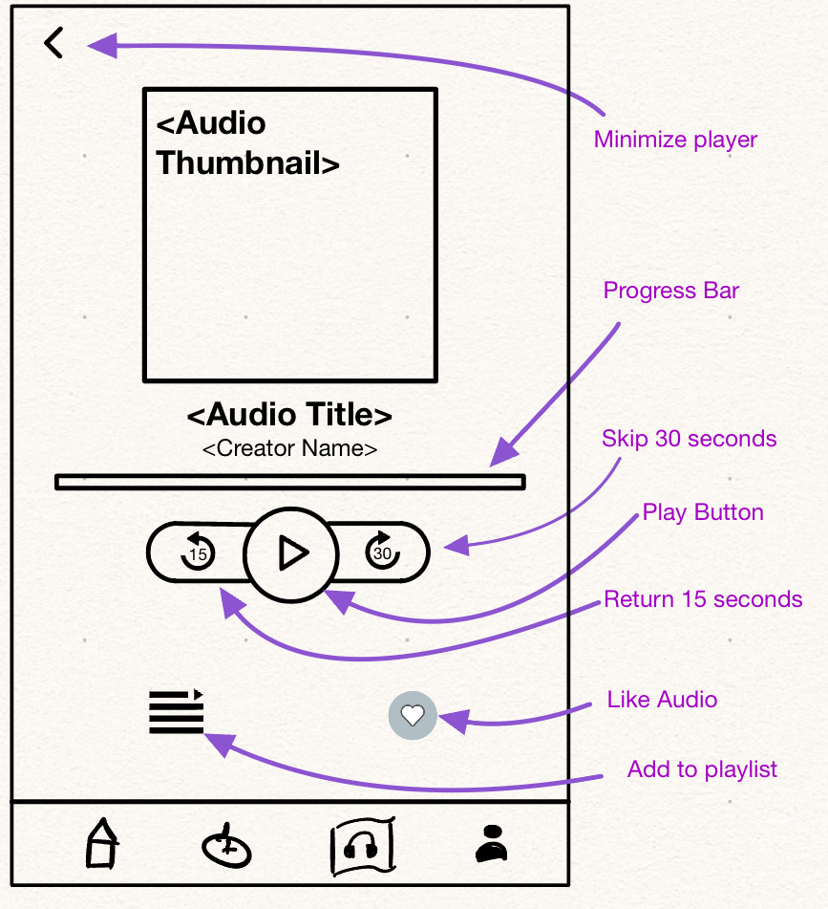
Audio Player Screen
Proprietary Media Player
Many useful actions

Slide 40
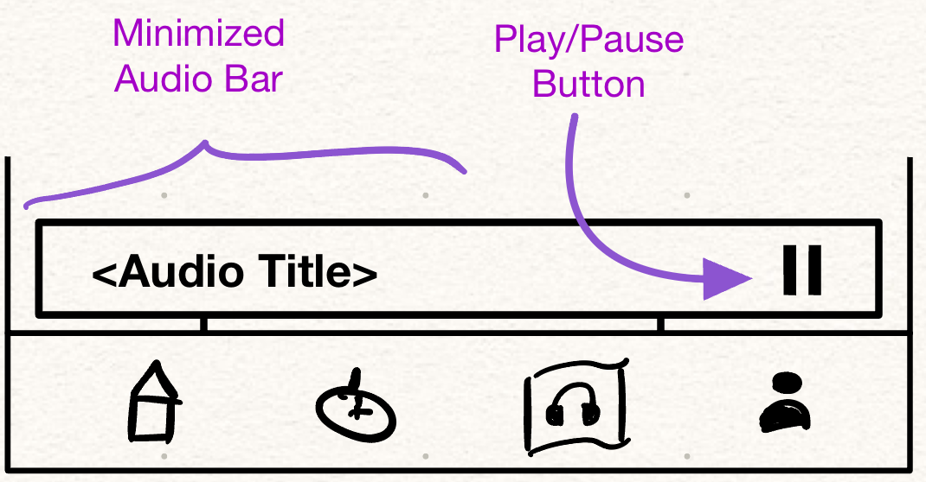
Minimized Audio Player Component
Is visible, floating above whatever is on the screen, when an audio is playing.

Slide 41
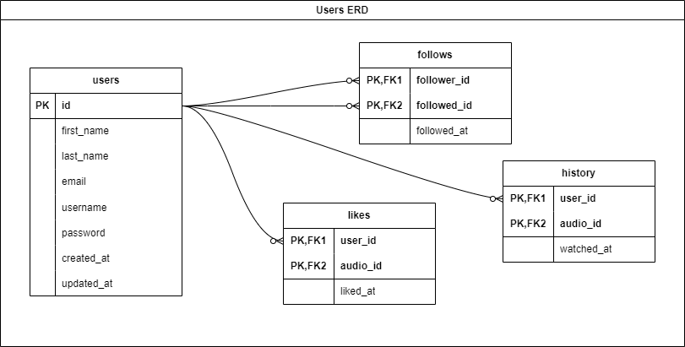
Data Storage
Overview of where user data, audio metadata, and playlist information are stored
Mention of the cloud storage solution for audio files

Slide 42
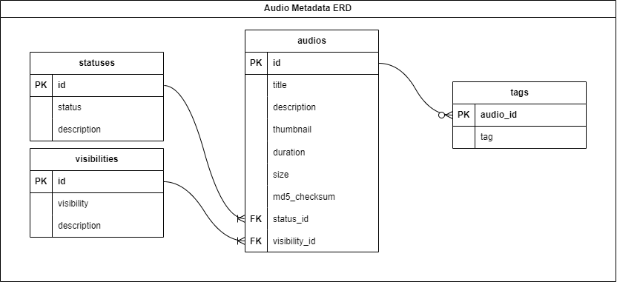
Audio File Storage

Slide 43
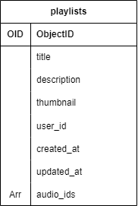
Playlist Information
Explanation of the playlist data structure
MongoDB (NoSQL)
Importance of managing playlists separately from other functionalities

Slide 44

Services
Dedicated services for each data context
Technologies used and containerization for scalability

Slide 45

API Gateway
How will the API Gateway look?
Wy did we choose to build it this way?

Slide 46

Testing Plan Overview
Objectives: Ensure functionality, performance, and user experience.
Testing methods: Manual and automated testing techniques.
Focus: Functional testing and usability testing using a black-box methodology.

Slide 47

Testing with Desktop and Mobile Devices
Desktop/laptop requirements: Minimum hardware capabilities.
Mobile devices: Testing on various platforms (iOS and Android) to ensure compatibility and functionality.

Slide 48

Software Testing Environments
Operating Systems: Windows, macOS, Android, iOS.
Web Browsers: Chrome, Firefox, Safari.
Testing Tools: Selenium for web tests, XCTest for iOS.

Slide 49
What we are going to test generally
User Management: Ensuring smooth registration and login processes.
Audio Management: Reliable audio upload, playback, and content management.
Search Functionality: Accurate and efficient search results.
Performance: Stability under load, scalability, and optimal resource utilization.
Concurrent Usage: Robust handling of multiple simultaneous users and actions.

Slide 50


Thank you for listening!
Link of our capstone project :-

